Slide 1
Smart Transportation System
TEAM NAME: TECH DUDES
DONE BY: SHIVA KRISHNA
ASWINI reddy
SAI CHANDANA

Slide 2
Abstract:-
One of the problem we are facing is Transportation issues.
We are solving this by our project which is aiming to track your GPS(Global Positioning System) location, by we are able to get traffic related information, tracking your location , getting latitude and longitude position, track the vehicles etc..
There will be a smart device through which we can get the GPS location and this data is sent to cloud and where this data is access through the node red UI. The data which is in Node red UI is read into app which can be created using MIT app inventor.

Slide 3
Block Diagram:
GPS MODULE (UBLOX GPS)
NODE MCU
IBM CLOUD
MOBILE APP

Slide 4
HARD WARE:
GPS module
NODE MCU
SOFT WARE:
ARDUINO IDE
NODE RED
MIT app inventor

Slide 5
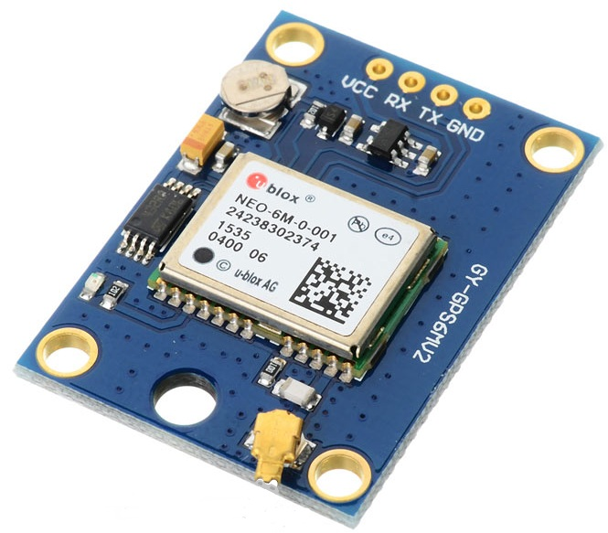
Pin Description: VCC: Power Supply 3.3 – 6 V GND : Ground TX: Transmit data serially which gives information about location, time etc. RX: Receive Data serially. It is required when we want to configure GPS module
GPS Module

Slide 6
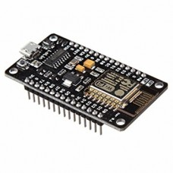
NODE MCU
NodeMCU is a open source IOT platform.
Specification of Node-MCU IoT Module :-
It is based on ESP8266 WiFi Soc.
Memory 128KBs.
Storage 4 MB.
13 GPIO pins .
Features of Node-MCU IoT Module:-
Open source IoT Platform
Easily Programmable
Low cost & Simple to Implement
WI-FI enabled

Slide 7
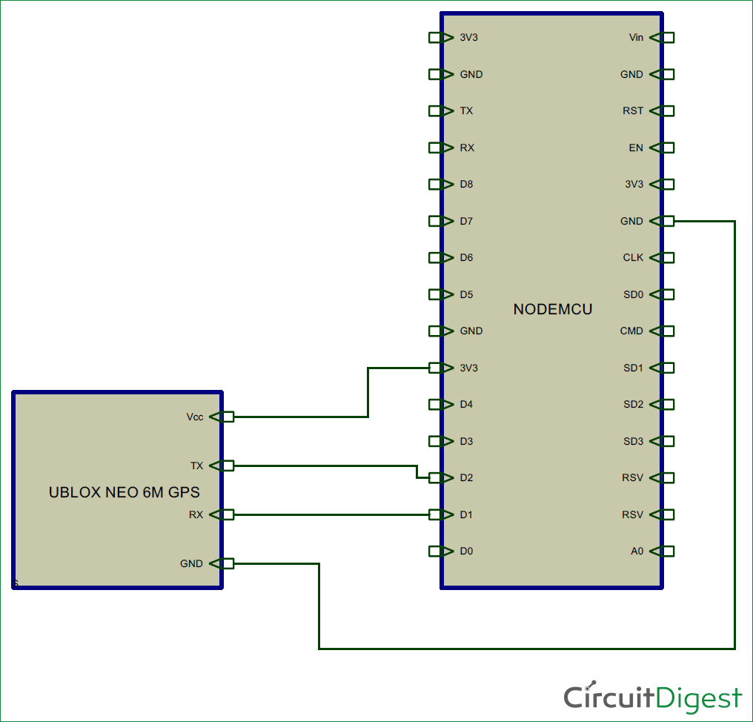
Connections:

Slide 8
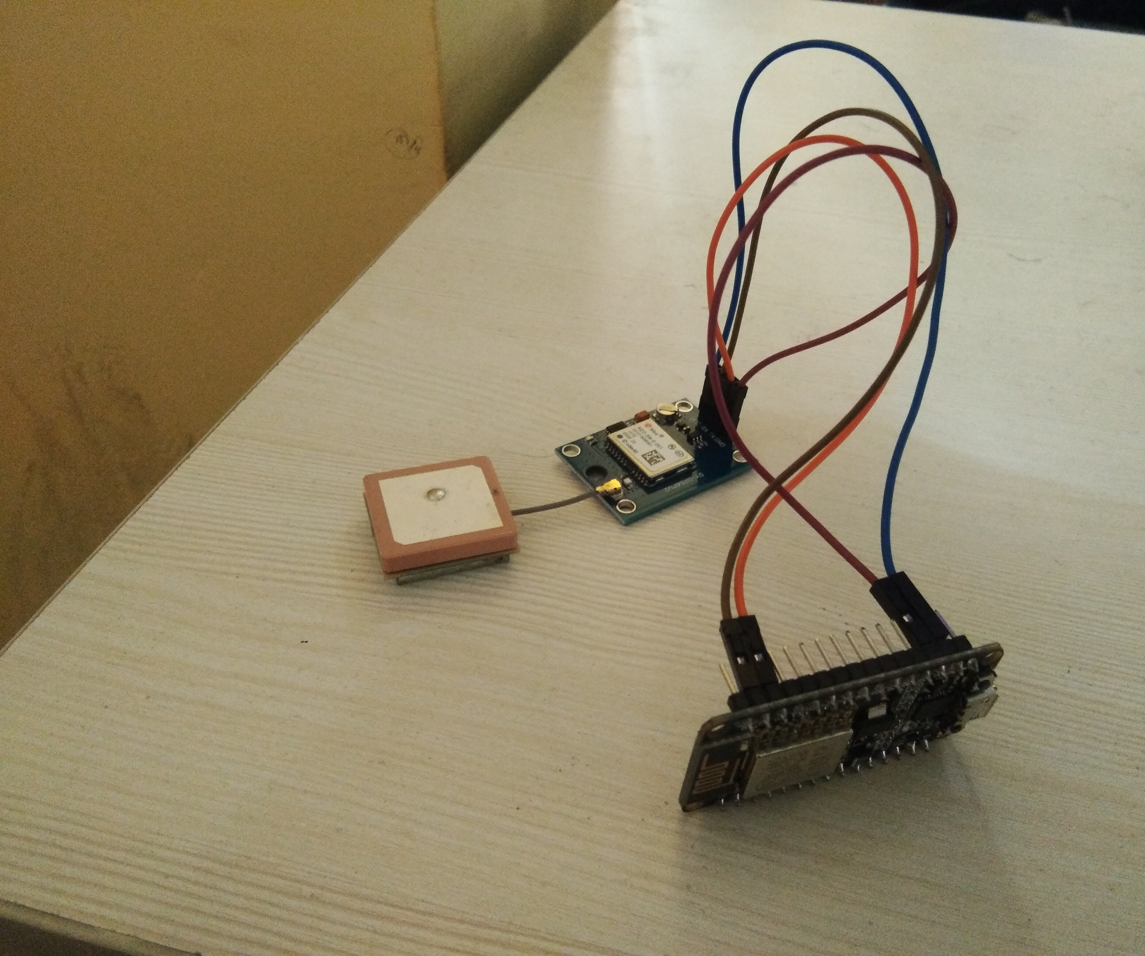

Slide 9
Working

Slide 10
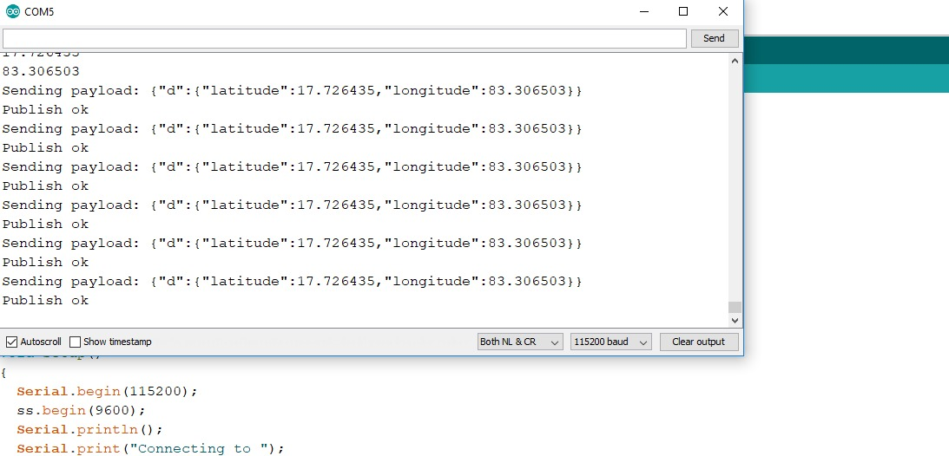
Serial Monitor :

Slide 11
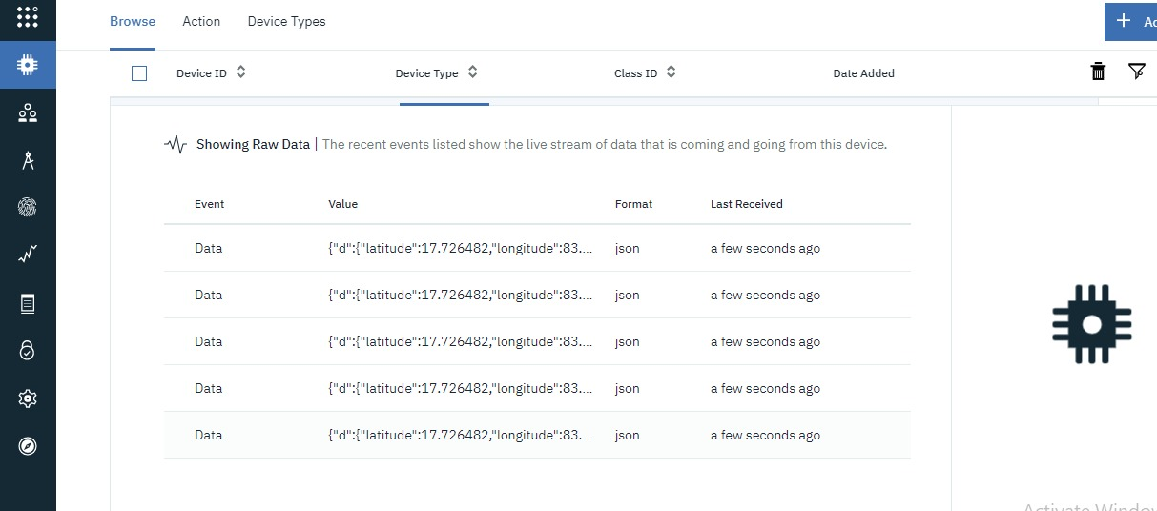
IBM Cloud:

Slide 12
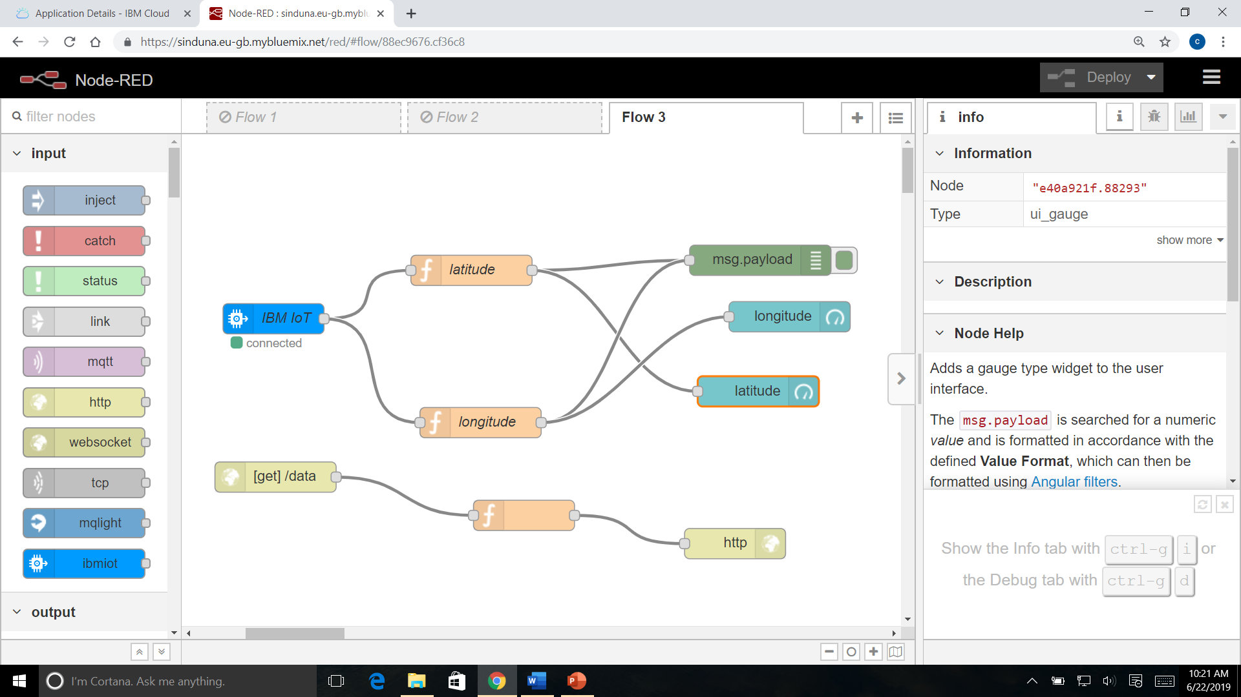
NODE RED:

Slide 13
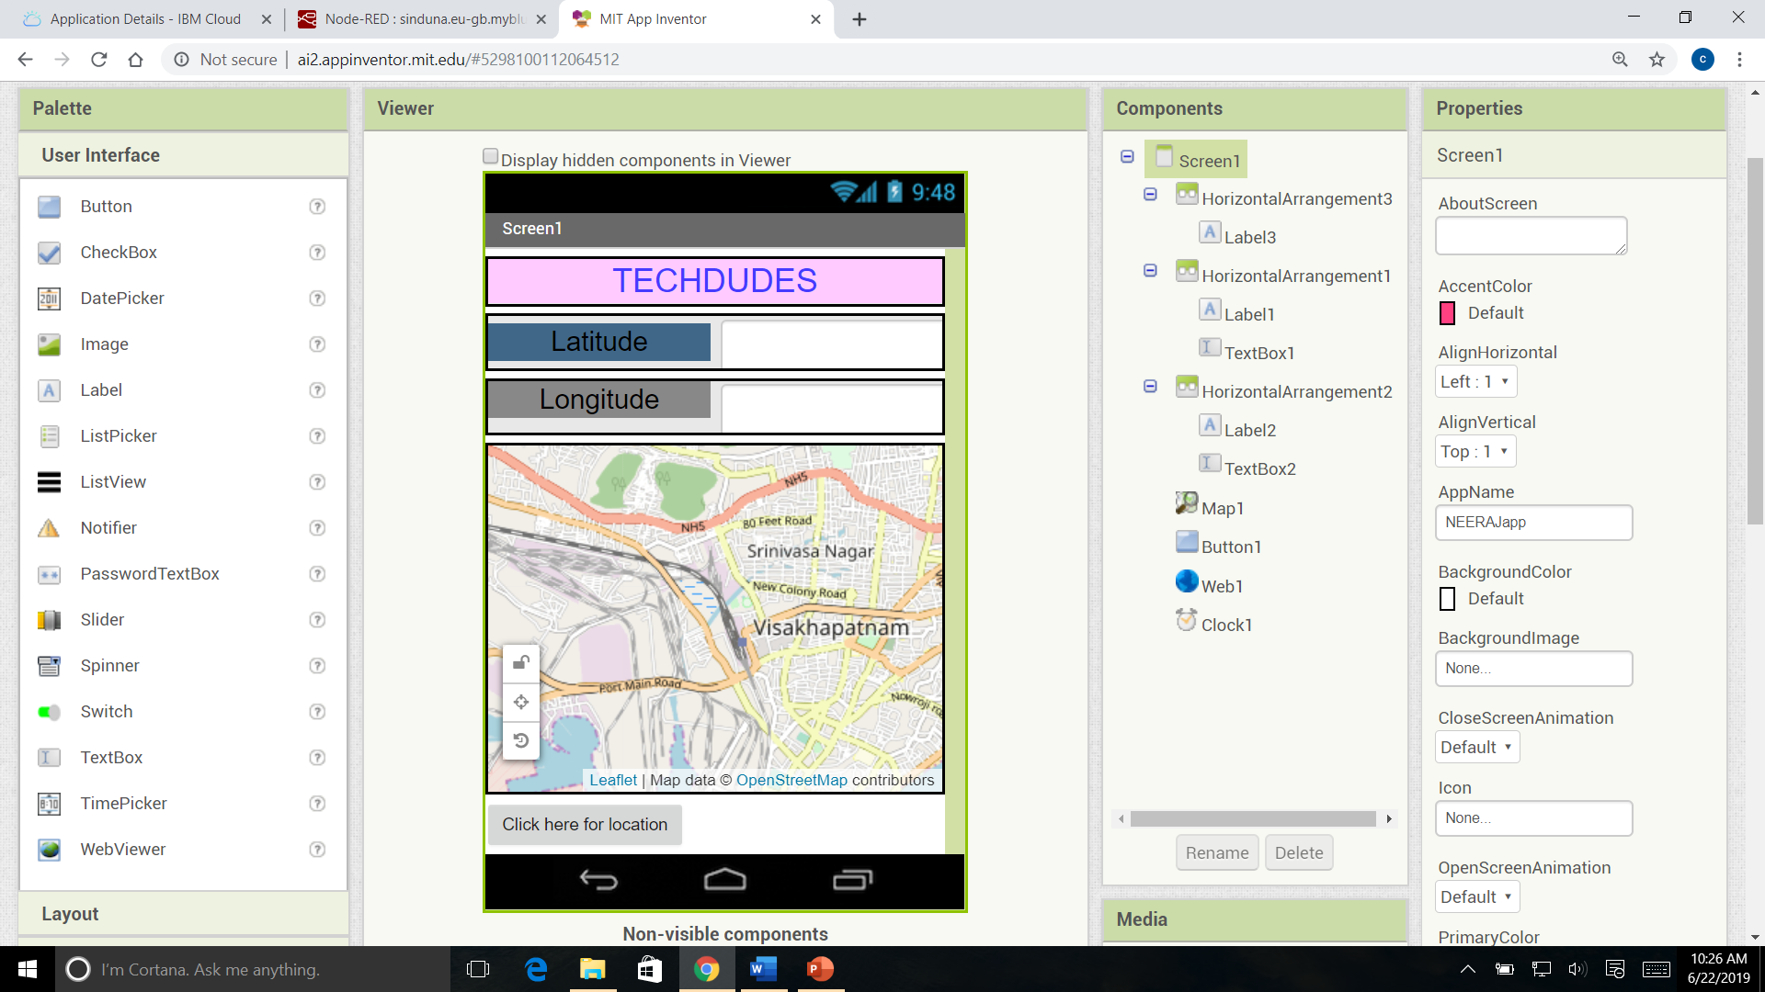
MIT Inventor:

Slide 14
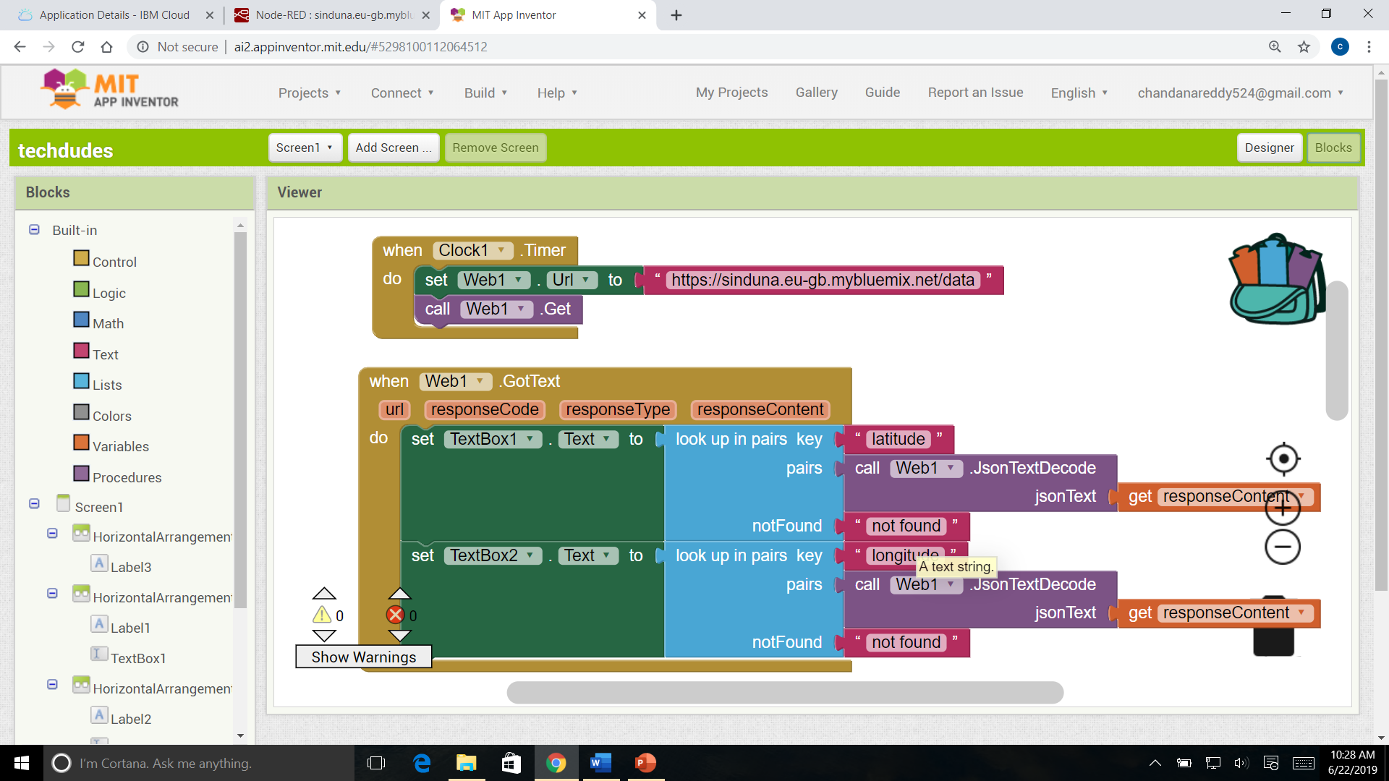

Slide 15
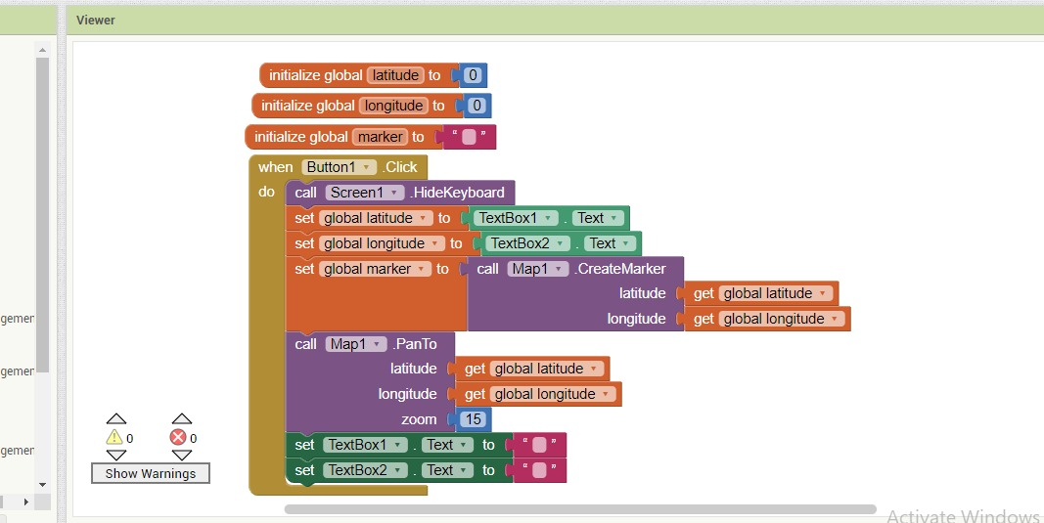

Slide 16
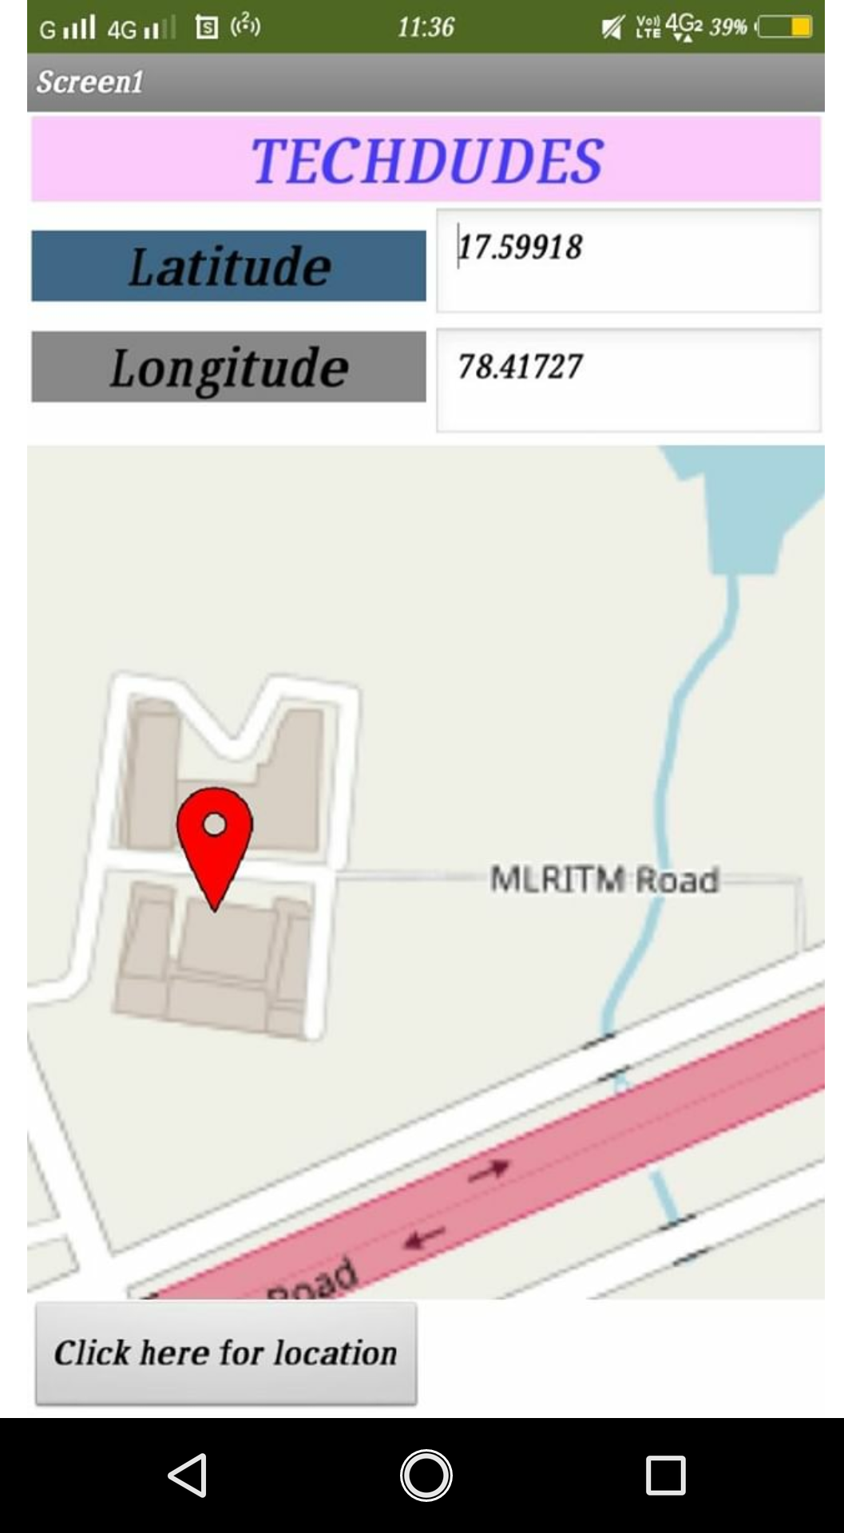
Output

Slide 17
Conclusion :-
In this project we are getting GPS location through app . Here GPS module send signals through transmitter to GPS satellite and get the location through receiver and it communicates with Node MCU through UART protocol and this received data is loaded into the cloud and app . By this are getting the live updates of our location and we can manipulate this data and used for many purposes.
Future Scope :-
This project has a huge future scope that we can implement Multimodal dynamic routing , Scheduling, Intelligent mobility information services for citizens, Innovative transportation solutions many.

Slide 18
THANK YOU

